Slide 1
CAPSTONE I.
REAL ESTATE DATA.
Created by Elena Blake Nov, 2024

Slide 2
Content
Project Purpose
Dataset Exploration and Visualization
T-test 1br/2br Nationwide
T-test 1br/2br per State
Takeaways and Further Considerations

Slide 3
Project Purpose
Real estate remains the largest investment for most people in the United States. It’s no a surprise, that many discussions revolve around buying, selling or renting properties. I aim to investigate real estate inventory and analyze the price differences between one-bedroom and two-bedroom units across states.
My analysis will utilize data from USA Real Estate Dataset (kaggle.com). This dataset includes 2,226,382 entries and 12 variables: brokered by, status, price, bed (# of beds), bath (# of bathrooms), property/land size in acres, street, city, state, zip code, house size (house area/size/living space in square feet), previously sold date. This dataset covers 50 states plus United States territories. The goal of this research is to compare pricing of one-bedroom units with two bedroom units in various states and evaluate if the results are statistically significant.
This research could interest individuals looking to buy, sell or relocate, as well as real estate investors looking for best return on their capital.

Slide 4
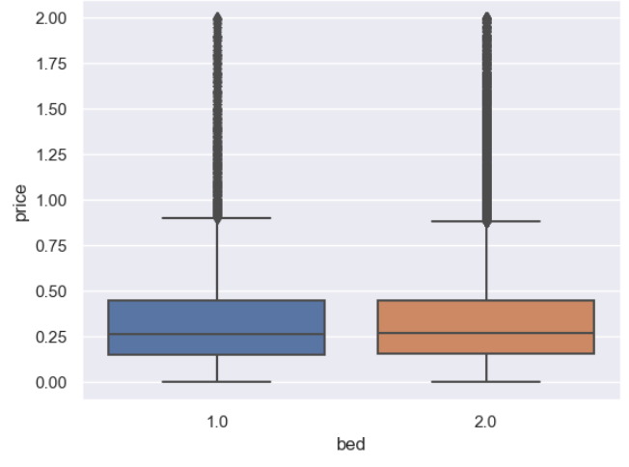
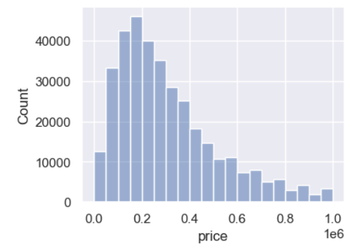
Data Exploration
Number of units per state varies from 21 in Guam to over 60,000 in Florida
Initial dataset shows a lot of price outliers per one- and two-bedroom units
Price will be capped at 1 mln as per the boxplot to eliminate outliers.
Distribution of the price variable appears normal, skewed to the right.

Slide 5
T-TEST 1BR/2BR NATIONWIDE
T test Result (statistic=2.2, P value=0.027)
One bedroom mean price $310,445
Two bedroom mean price $312,498
Nationwide analysis shows only 0.6% difference in one-br vs two-br mean prices. The result is statistically significant (p-value < 0.05) but not very significant (p-value < 0.01).

Slide 6
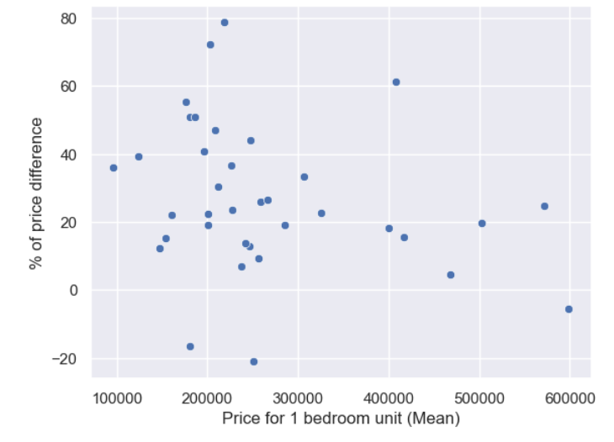
T-test 1br/2br per State
Out of 54 states and territories, 36 have very significant difference in one-br/two-br unit price (p-value<0.01).
3 states(New York, Oklahoma, Alabama) show opposite correlation: 1-br mean price is higher than 2-br mean price
% price difference varies from (-21%) in New York to (+78%) in New Hampshire

Slide 7
Takeaways and Further Considerations
Although the overall T-test showed significant difference between 1br/2br units price, the data has to be reviewed further due to inconsistencies and three states showing opposite correlation.
The explanation could be in certain features missing: luxury/basic amenities, distressed sales, number of bathrooms, size of units, etc. Also, in the state like New York with a lot of coop units, missing condo/coop classification would create a false comparison between condos and coops pricing. In New York at 1 mln cap 1br condos might be included while 2br condos not.

